Slide 1
BLOCK CIPHERS
STREAM CIPHER

Slide 2
STREAM CIPHER
A stream cipher is one that encrypts a digital data stream one bit or one byte at a
time.
For a stream cipher to be secure, the same keystream should
never be reused or else the attacker can obtain the exclusive OR of two
plaintext messages, which enables a statistical attack to recover both the
plaintext and the keystream.

Slide 3
STREAM CIPHER
a stream cipher, which is a symmetric
cryptosystem where the ciphertext C is obtained as the exclusive OR of the
plaintext message M and a pseudo-random binary vector S generated from
the secret key, called keystream:

Slide 4
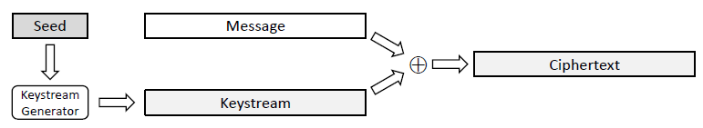
STREAM CIPHER
The essence of a stream cipher is the method for generating a keystream
of arbitrary length from the secret key, which serves as a seed.

Slide 5
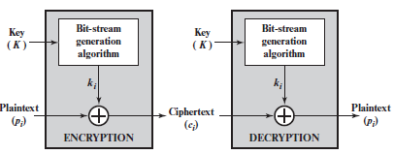
STREAM CIPHER
It must be computationally impractical to predict future portions of
the bit stream based on previous portions of the bit stream. The two users need only
share the generating key, and each can produce the keystream.

Slide 6
Stream Cipher
Encrypt digital data stream one bit or byte at a time
Examples:
Autokeyed Vigenère cipher
Vernam cipher
One-time pad
keystream is as long as the plaintext stream
Unconditional security
Logistical problems
Pseudorandom generators
The keystream is generated by an algorithmic procedure that both the sender and receiver can implement
Must be computationally hard to predict portions of the bit stream based on previous portions of the bit stream
The two users need only share the generating key used to produce the keystream
Keystream must be distributed to the receiver in advance via a secure channel

Slide 7
Block Cipher
A block of plaintext is treated as a whole and used to produce a ciphertext block of equal length
Typically a block size of 64 or 128 bits is used
As with a stream cipher, the two users share a symmetric encryption key
A majority of symmetric key applications use block ciphers

Slide 8
Modern Block Ciphers
now look at modern block ciphers
one of the most widely used types of cryptographic algorithms
provide secrecy /authentication services
focus on DES (Data Encryption Standard)
to illustrate block cipher design principles
Notes:
Modern block ciphers are widely used to provide encryption of quantities of information, and/or a cryptographic checksum to ensure the contents have not been altered. We continue to use block ciphers because they are comparatively fast, and because we know a fair amount about how to design them. Will use the widely known DES algorithm to illustrate some key block cipher design principles.

Slide 9
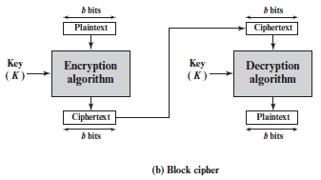
Modern Block Ciphers

Slide 10
Modern Block Ciphers
Modern block ciphers are widely used to provide encryption of quantities of information, and/or a cryptographic checksum to ensure the contents have not been altered. We continue to use block ciphers because they are comparatively fast, and because we know a fair amount about how to design them. Will use the widely known DES algorithm to illustrate some key block cipher design principles.

Slide 11
Block vs Stream Ciphers
block ciphers process messages in blocks, each of which is then en/decrypted
like a substitution on very big characters
64-bits or more
stream ciphers process messages a bit or byte at a time when en/decrypting
many current ciphers are block ciphers
broader range of applications
Notes:
Block ciphers work a on block / word at a time, which is some number of bits. All of these bits have to be available before the block can be processed. Stream ciphers work on a bit or byte of the message at a time, hence process it as a “stream”. Block ciphers are currently better analysed, and seem to have a broader range of applications, hence focus on them.

Slide 12
Block vs Stream Ciphers
Block ciphers work a on block / word at a time, which is some number of bits. All of these bits have to be available before the block can be processed. Stream ciphers work on a bit or byte of the message at a time, hence process it as a “stream”. Block ciphers are currently better analysed, and seem to have a broader range of applications, hence focus on them.

Slide 13
Block Cipher Principles
most symmetric block ciphers are based on a Feistel Cipher Structure
needed since must be able to decrypt ciphertext to recover messages efficiently
block ciphers look like an extremely large substitution
would need table of 2⁶⁴ entries for a 64-bit block
instead create from smaller building blocks
using idea of a product cipher
Notes:
Most symmetric block encryption algorithms in current use are based on a structure referred to as a Feistel block cipher. A block cipher operates on a plaintext block of n bits to produce a ciphertext block of n bits. An arbitrary reversible substitution cipher for a large block size is not practical, however, from an implementation and performance point of view. In general, for an n-bit general substitution block cipher, the size of the key is n x 2^{n}. For a 64-bit block, which is a desirable length to thwart statistical attacks, the key size is 64 x 2⁶⁴ = 2⁷⁰ = 10²¹ bits. In considering these difficulties, Feistel points out that what is needed is an approximation to the ideal block cipher system for large n, built up out of components that are easily realizable.

Slide 14
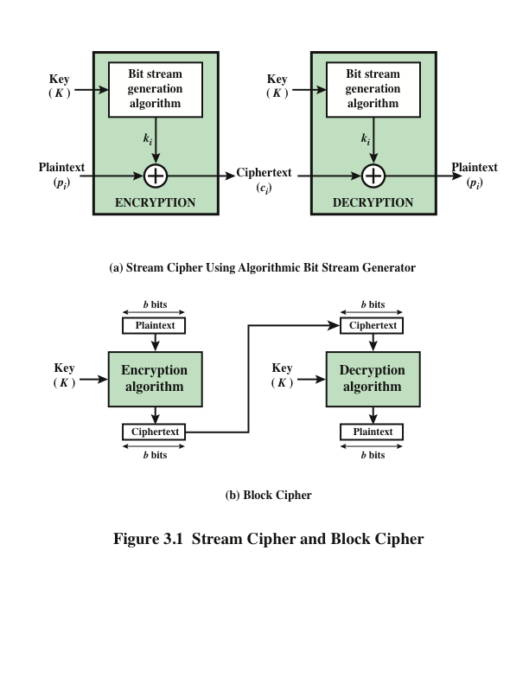
Block Cipher Principles
BLOCK & STREAM CIPHER

Slide 15
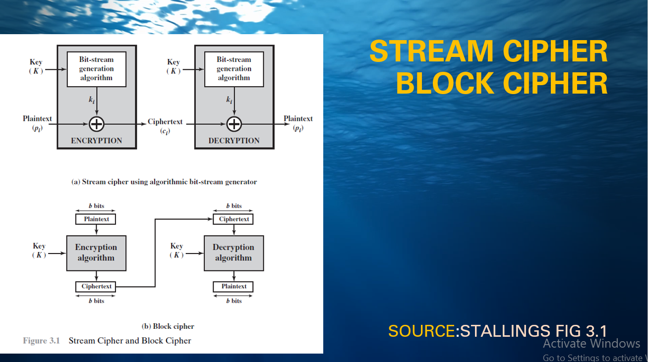

Slide 16
Block Cipher Principles
Most symmetric block encryption algorithms in current use are based on a structure referred to as a Feistel block cipher. A block cipher operates on a plaintext block of n bits to produce a ciphertext block of n bits. An arbitrary reversible substitution cipher for a large block size is not practical, however, from an implementation and performance point of view. In general, for an n-bit general substitution block cipher, the size of the key is n x 2^{n}. For a 64-bit block, which is a desirable length to thwart statistical attacks, the key size is 64 x 2⁶⁴ = 2⁷⁰ = 10²¹ bits. In considering these difficulties, Feistel points out that what is needed is an approximation to the ideal block cipher system for large n, built up out of components that are easily realizable.

Slide 17
BLOCK CIPHER
Feistel refers to an n-bit general substitution as an ideal block cipher, because it allows for the maximum number of possible encryption mappings from the plaintext to ciphertext block. A 4-bit input produces one of 16 possible input states, which is mapped by the substitution cipher into a unique one of 16 possible output states, each of which is represented by 4 ciphertext bits. The encryption and decryption mappings can be defined by a tabulation, as shown in Stallings Figure 3.1. It illustrates a tiny 4-bit substitution to show that each possible input can be arbitrarily mapped to any output - which is why its complexity grows so rapidly.

Slide 18
Block Cipher Principles
Most symmetric block encryption algorithms in current use are based on a structure referred to as a Feistel block cipher. A block cipher operates on a plaintext block of n bits to produce a ciphertext block of n bits. An arbitrary reversible substitution cipher for a large block size is not practical, however, from an implementation and performance point of view. In general, for an n-bit general substitution block cipher, the size of the key is n x 2^{n}. For a 64-bit block, which is a desirable length to thwart statistical attacks, the key size is 64 x 2⁶⁴ = 2⁷⁰ = 10²¹ bits. In considering these difficulties, Feistel points out that what is needed is an approximation to the ideal block cipher system for large n, built up out of components that are easily realizable.

Slide 19
BLOCK CIPHER
Feistel refers to an n-bit general substitution as an ideal block cipher, because it allows for the maximum number of possible encryption mappings from the plaintext to ciphertext block. A 4-bit input produces one of 16 possible input states, which is mapped by the substitution cipher into a unique one of 16 possible output states, each of which is represented by 4 ciphertext bits. The encryption and decryption mappings can be defined by a tabulation, as shown in Stallings Figure 3.1. It illustrates a tiny 4-bit substitution to show that each possible input can be arbitrarily mapped to any output - which is why its complexity grows so rapidly.

Slide 20
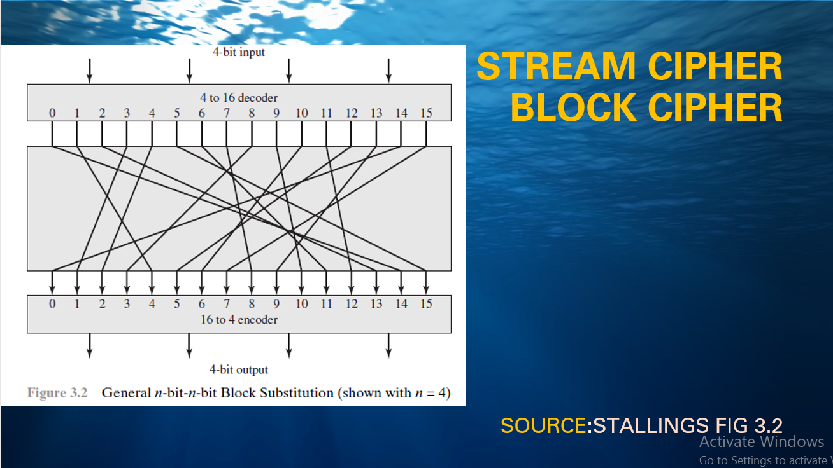
Ideal Block Cipher stallings fig 3.2
Notes:
Feistel refers to an n-bit general substitution as an ideal block cipher, because it allows for the maximum number of possible encryption mappings from the plaintext to ciphertext block. A 4-bit input produces one of 16 possible input states, which is mapped by the substitution cipher into a unique one of 16 possible output states, each of which is represented by 4 ciphertext bits. The encryption and decryption mappings can be defined by a tabulation, as shown in Stallings Figure 3.1. It illustrates a tiny 4-bit substitution to show that each possible input can be arbitrarily mapped to any output - which is why its complexity grows so rapidly.

Slide 21
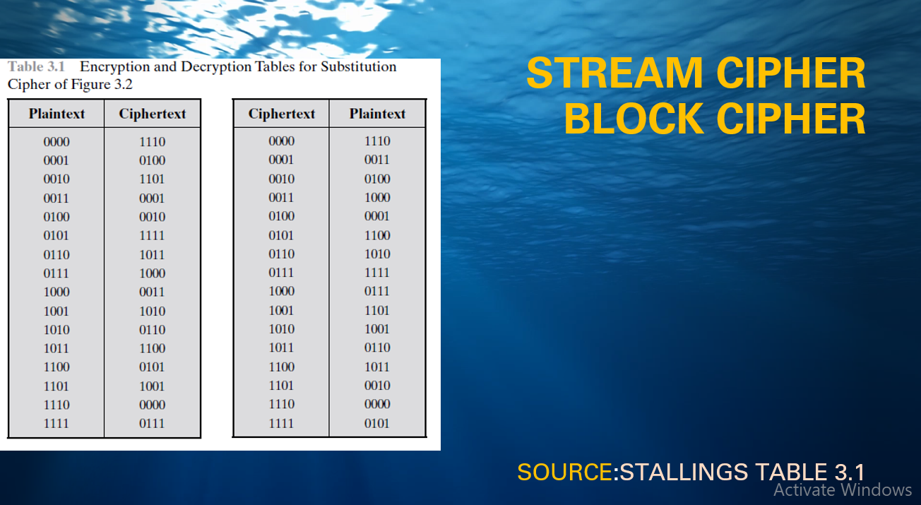
Ideal Block Cipher stallings fig 3.2
Notes:
Feistel refers to an n-bit general substitution as an ideal block cipher, because it allows for the maximum number of possible encryption mappings from the plaintext to ciphertext block. A 4-bit input produces one of 16 possible input states, which is mapped by the substitution cipher into a unique one of 16 possible output states, each of which is represented by 4 ciphertext bits. The encryption and decryption mappings can be defined by a tabulation, as shown in Stallings Figure 3.1. It illustrates a tiny 4-bit substitution to show that each possible input can be arbitrarily mapped to any output - which is why its complexity grows so rapidly.

Slide 22
Claude Shannon and Substitution-Permutation Ciphers
Claude Shannon introduced idea of substitution-permutation (S-P) networks in 1949 paper
form basis of modern block ciphers
S-P nets are based on the two primitive cryptographic operations seen before:
substitution (S-box)
permutation (P-box)
provide confusion & diffusion of message & key
Notes:
Claude Shannon’s 1949 paper has the key ideas that led to the development of modern block ciphers. Critically, it was the technique of layering groups of S-boxes separated by a larger P-box to form the S-P network, a complex form of a product cipher. He also introduced the ideas of confusion and diffusion, notionally provided by S-boxes and P-boxes (in conjunction with S-boxes).

Slide 23
CONFUSION DIFFUSION
Claude Shannon’s 1949 paper has the key ideas that led to the development of modern block ciphers. Critically, it was the technique of layering groups of S-boxes separated by a larger P-box to form the S-P network, a complex form of a product cipher. He also introduced the ideas of confusion and diffusion, notionally provided by S-boxes and P-boxes (in conjunction with S-boxes).

Slide 24
Confusion and Diffusion
cipher needs to completely obscure statistical properties of original message
a one-time pad does this
more practically Shannon suggested combining S & P elements to obtain:
diffusion – dissipates statistical structure of plaintext over bulk of ciphertext
confusion – makes relationship between ciphertext and key as complex as possible
Notes:
The terms diffusion and confusion were introduced by Claude Shannon to capture the two basic building blocks for any cryptographic system. Every block cipher involves a transformation of a block of plaintext into a block of ciphertext, where the transformation depends on the key. The mechanism of diffusion seeks to make the statistical relationship between the plaintext and ciphertext as complex as possible in order to thwart attempts to deduce the key. Confusion seeks to make the relationship between the statistics of the ciphertext and the value of the encryption key as complex as possible, again to thwart attempts to discover the key.
So successful are diffusion and confusion in capturing the essence of the desired attributes of a block cipher that they have become the cornerstone of modern block cipher design.

Slide 25
CONFUSION DIFFUSION
The terms diffusion and confusion were introduced by Claude Shannon to capture the two basic building blocks for any cryptographic system. Every block cipher involves a transformation of a block of plaintext into a block of ciphertext, where the transformation depends on the key. The mechanism of diffusion seeks to make the statistical relationship between the plaintext and ciphertext as complex as possible in order to thwart attempts to deduce the key. Confusion seeks to make the relationship between the statistics of the ciphertext and the value of the encryption key as complex as possible, again to thwart attempts to discover the key.
So successful are diffusion and confusion in capturing the essence of the desired attributes of a block cipher that they have become the cornerstone of modern block cipher design.

